Slide 1
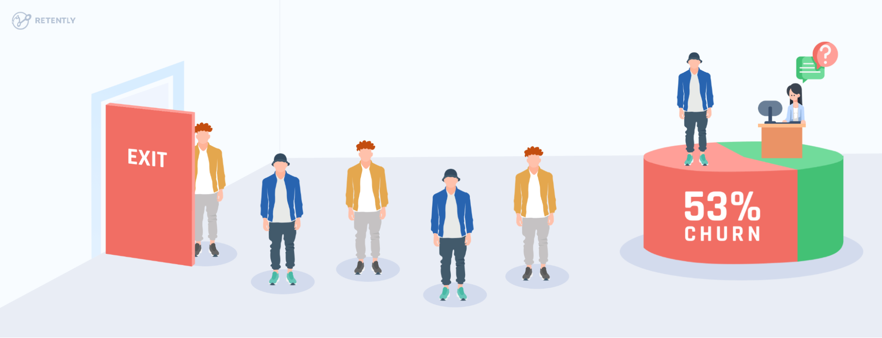
Customer Churn
Prediction

Slide 2

Team Members
Kunal Mallick
Ajay Anap
Abhishek Bhonde
Parvati Tambe
Harsh Dalal

Slide 3

Mentor
Kunal Mallick
Kunal Mallick

Slide 4

Customer churn is a big problem for telecommunications companies. Indeed, their annual churn rates are usually higher than 10%. For that reason, they develop strategies to keep as many clients as possible. This is a classification project since the variable to be predicted is binary (churn or loyal customer). The goal here is to model churn probability, conditioned on the customer features.
Objective

Slide 5

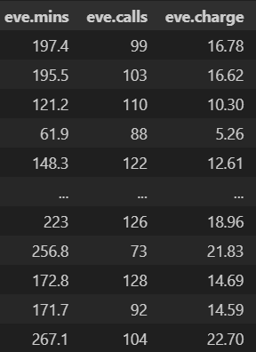
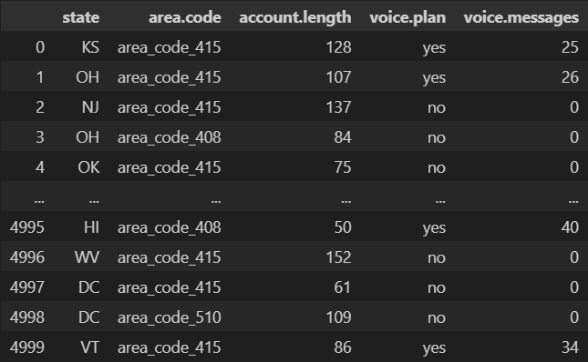
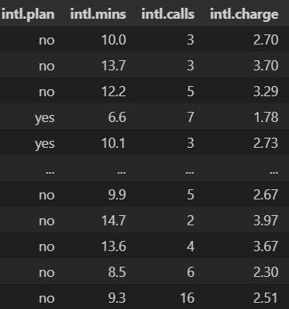
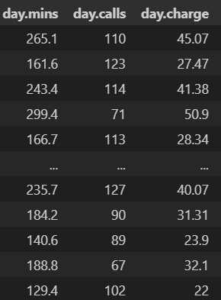
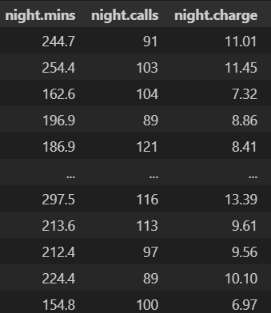
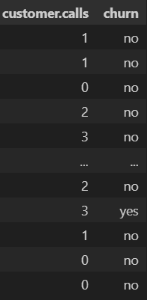
Loading The Datasets

Slide 6

Data Description
state: Categorical, for the 51 states and the District of Columbia.
Area.code
account.length: how long the account has been active.
voice.plan: yes or no, voicemail plan.
voice.messages: number of voicemail messages.
intl.plan: yes or no, international plan.
intl.mins: minutes customer used service to make international calls.
intl.calls: total number of international calls.
intl.charge: total international charge.
day.mins: minutes customer used service during the day.
day.calls: total number of calls during the day.
day.charge: total charge during the day.
eve.mins: minutes customer used service during the evening.
eve.calls: total number of calls during the evening.
eve.charge: total charge during the evening.
night.mins: minutes customer used service during the night.
night.calls: total number of calls during the night.
night.charge: total charge during the night.
customer.calls: number of calls to customer service.
churn: Categorical, yes or no. Indicator of whether the customer has left the company (yes or no).

Slide 7


Slide 8

Running Describe

